Slide 1

Non-parametric Homogeneity Test

Slide 2
Homogeneity Test
Between Two Groups?
Yes
No
t-test
Welch’s t-test
Wilcoxon rank-sum test
ANOVA
Kruskal-Wallis test

Slide 3
Homogeneity Test
Two Groups
Normal ?
Yes
No
t-test
Welch’s t-test
Wilcoxon rank-sum test

Slide 4
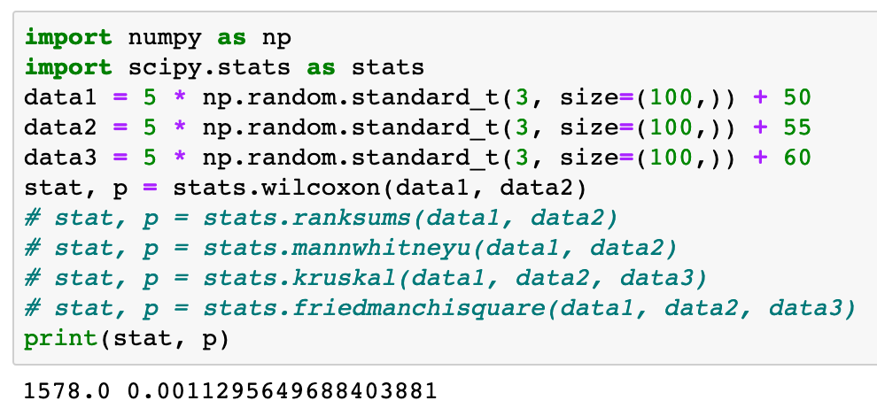

Slide 5
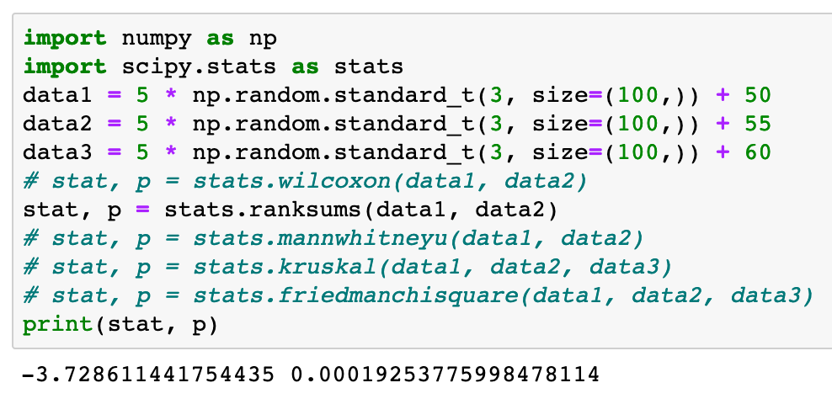

Slide 6
Homogeneity Test
Many Groups
Normal ?
Yes
No
ANOVA
Kruskal-Wallis test

Slide 7
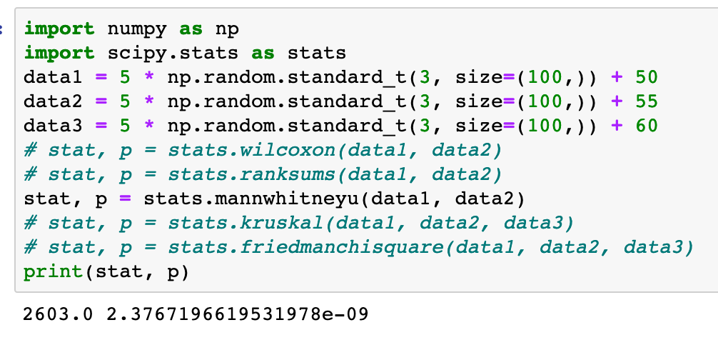

Slide 8
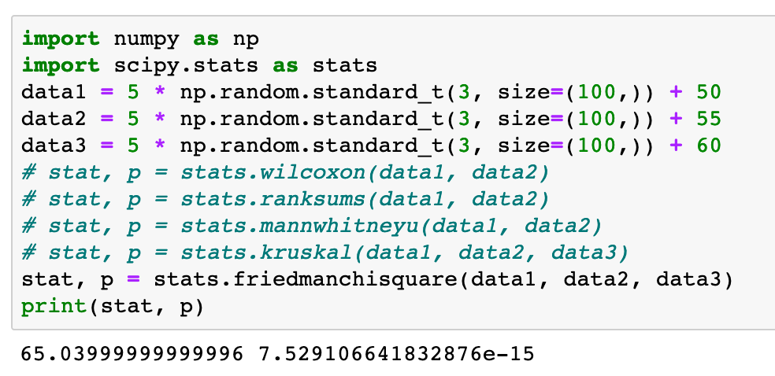

Slide 9
